Slide 1
Chapter 1. Introduction

Slide 2
Key Takeaway Points
• Software engineering aims to significantly improve software productivity and software quality while reducing software costs and time to market.
Software engineering consists of three tracks of interacting life cycle activities:
  software development process
  software quality assurance, and
  software project management
Object-oriented (OO) software engineering is a specialization of software engineering. It views the world and systems as consisting of objects that interact with each other.
1-<number>

Slide 3
What Is Software Engineering?
Software engineering as a discipline is focused on
  research, education, and application of engineering processes and methods
  to significantly increase software productivity (P) and software quality (Q) while reducing software costs (C) and time to market (T) – software PQCT.
1-<number>

Slide 4
Why Software Engineering?
Software is expanding into all sectors of our society:
  Companies rely on software to run and expand their businesses.
  Software systems are getting larger and more complex – millions of lines of code.
  Software costs are 90 – 95% of total system costs (software costs were only 5 – 10% of total system costs two decades ago.)
  Embedded systems contain application specific integrated circuits (ASIC), which are costly to replace – software quality is critical.
We need an engineering approach to software development.
1-<number>

Slide 5
Why Software Engineering?
Large software systems development requires teamwork and software engineering supports teamwork.
  A typical software engineer produces an average 50–100 lines of source code per day.
  A small system of 10,000 lines of code requires one software engineer to work between 100 and 200 days or 5 to 10 months.
  A medium-size system of 500,000 lines of code requires a software engineer to work 5,000 to 10,000 days or 20 to 40 years.
Real-world software systems require many software engineers to work together to jointly develop a software system.
1-<number>

Slide 6



Why Software Engineering?
To work together, the software engineers must overcome three challenges, among others:
Conceptualization
Communication
Coordination
Solution:
Processes and methodologies for analysis and design
UML for communication and coordination
Tools that automate or support methodology steps.
1-<number>

Slide 7







Software Life Cycle Activities
Software processes and methodologies consist of life cycle activities:
Productivity
Quality
Cost
Time to Market
Software Development Process
Software Quality Assurance
Software Project Management
1-<number>

Slide 8
Software Development Process
A software development process transforms the initial system concept into the operational system running in the target environment.
It identifies the business needs, conducts a feasibility study, and formulates the requirements or capabilities that the system must deliver.
It also designs, implements, tests, and deploys the system to the target environment.
1-<number>

Slide 9
The Waterfall Process
System Engineering
Software Requirements Analysis
Software Design
Coding & Unit Testing
Integration & Integration Testing
Acceptance Testing
Maintenance
1-<number>

Slide 10
Software Quality Assurance
Software quality assurance (SQA) ensures that
  the development activities are performed properly, and
  the software artifacts produced by the development activities meet the software requirements and desired quality standards.
1-<number>

Slide 11
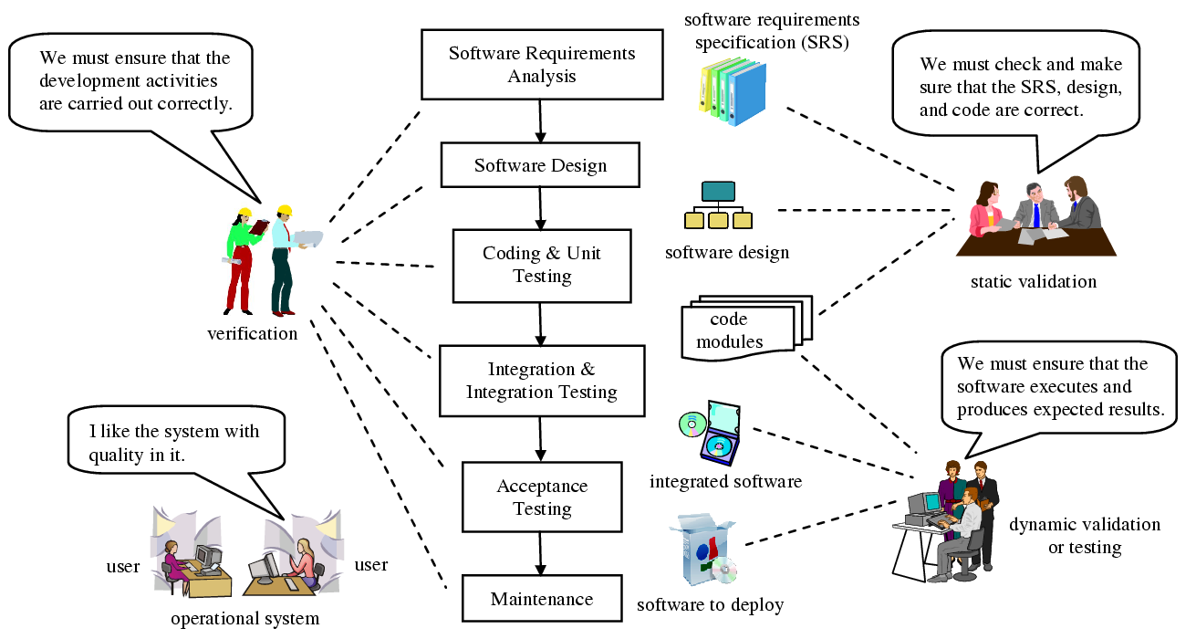
SQA Activities
1-<number>

Slide 12
Software Project Management
Software project management oversees the control and administration of the development and SQA activities.
Project management activities include
  effort estimation
  project planning and scheduling
  risk management
  project administration, and
  others.
These activities ensure that the software system is delivered on time and within budget.
1-<number>

Slide 13
Object-Oriented Software Engineering
Object-oriented software engineering (OOSE) is a specialization of software engineering.
The object-oriented paradigm views the world and systems as consisting of objects that relate and interact with each other.
OOSE encompasses:
  OO processes
  OO methodologies
  OO modeling languages
  OO tools
1-<number>

Slide 14
Software Engineering and Computer Science
Computer Science
Pursue optimal solutions
$$$ is not an important consideration
Programming in the small
Technical issues
Dealing with tame problems
Foundations of software engineering
Software Engineering
Good enough is enough
$$$ is an important factor (PQCT)
Programming in the large
All issues and aspects
Dealing with wicked problems
Building on top of computer science and other disciplines
Tame vs wicked problems: http://www.open.ac.uk/cpdtasters/gb052/index.htm
1-<number>

Slide 15


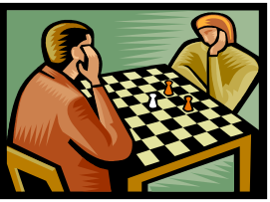

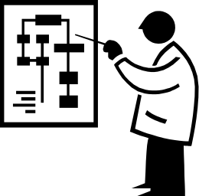
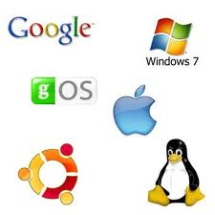
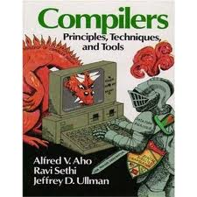

Examples of Tame Problem
Operations research
Chess playing
Math problems
Many computer science problems
Query optimization
AI problems
Compiler construction
Operating systems
Why are these tame problems?
1-<number>

Slide 16


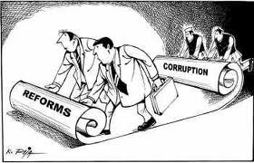
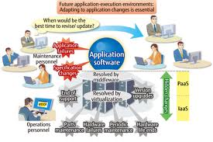

Examples of Wicked Problem
Urban planning
National policy making
Why are these wicked problems?
Application software
development
Economic reforms
1-<number>

Slide 17
Class Discussion
What are the benefits of OOSE?
Will OOSE replace the conventional approaches, and why?
1-<number>

Slide 18
Class Discussion
What are the focuses of computer science and software engineering, respectively?
Some authors say that software engineering is “programming in the large.” What does this mean?
What is the relationship between software engineering and computer science? Can you have one without the other?
1-<number>

